Slide 1
SALES DATA ANALYSIS
Submitted BY :
Rishika Chaudhary
1710110276
ECE-2021
Shiv Nadar University

Slide 2
OVERVIEW OF THE DATASET
1

Slide 3
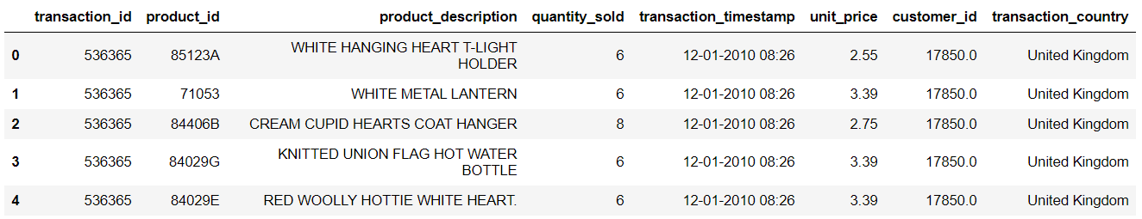
This is a transnational data set which contains all the transactions occurring between 01/12/2010 and 09/12/2011 for a UK-based and registered non-store online retail.
The dataset has 5,41,909 records and 8 attributes.
The data shows the details for each single transaction, the customer Id of 17850 of United Kingdom has the transaction_id of 536365 and has ordered various products

Slide 4
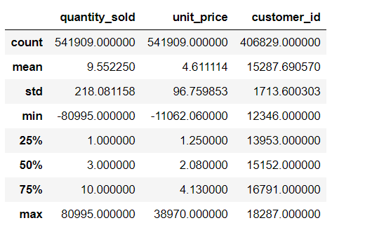
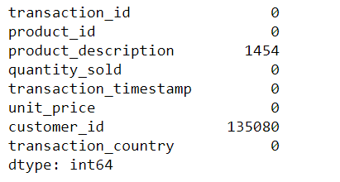
After looking at the stats of the dataset, we observe a few strange values-
The dataset has a minimum of negative quantities sold
The dataset has a minimum of negative unit price.
The mean unit price is very less than the maximum price, so we have outliers.
On the right we have all the null values for our dataset, we observe
Null values in customer id
Null values in product description

Slide 5
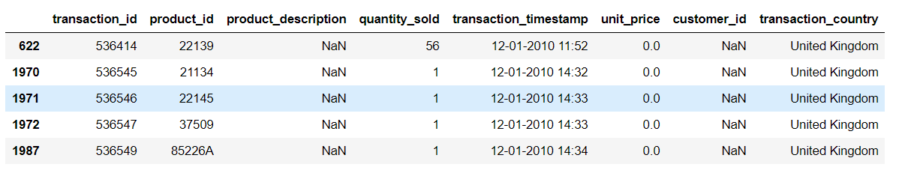
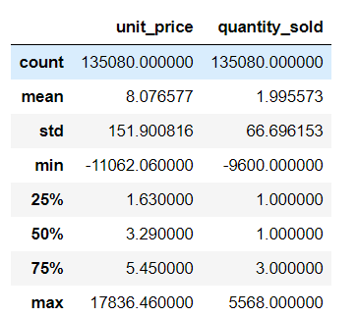
When the customer ID is missing, we have 0 as the unit price and the product description is a NAN string.
With customer ID missing, we have unusual values of unit price and quantity sold with negative entries, which is not possible.
As we are not aware of why the customer id’s are missing and the corresponding unit prices and quantities show strange values and outliers we will drop them as a part of our data cleaning process.

Slide 6

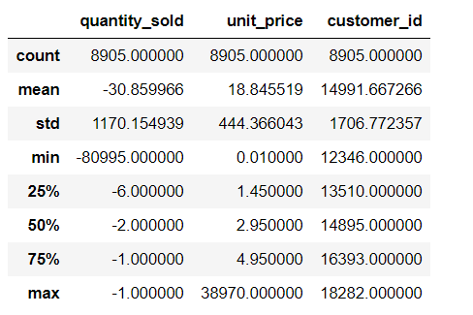
A prefix of ‘C’ in each transaction id suggests that the order was cancelled.
According to the result above, 2.19% of orders were cancelled transactions.
The cancelled transactions have negative quantities, mean is also negative and positive unit prices, the quantities will act as outliers and so for appropriate visualisation we should remove these entries.

Slide 7
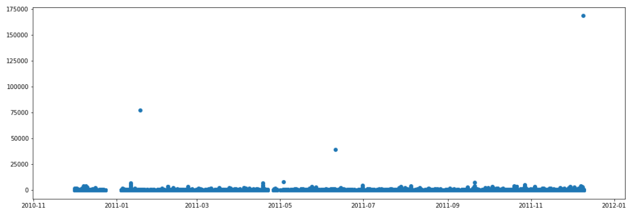
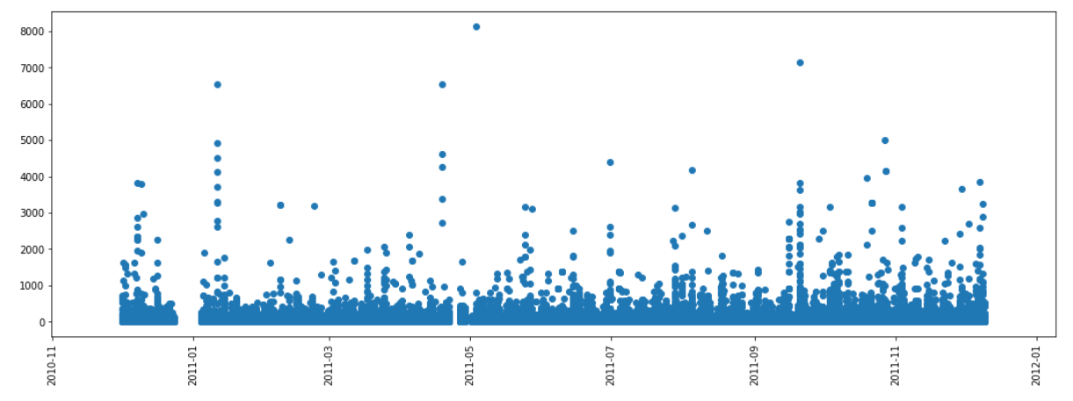
REVENUE COLUMN
An important feature addition is to add the attribute column to the dataset, to measure the trend of sales over the months.
As observed from the graph above that, any value above 2500 is an outlier, so it was removed and we obtain this graph.

Slide 8
VISUALISATION OF DATASET
2

Slide 9
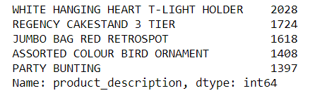
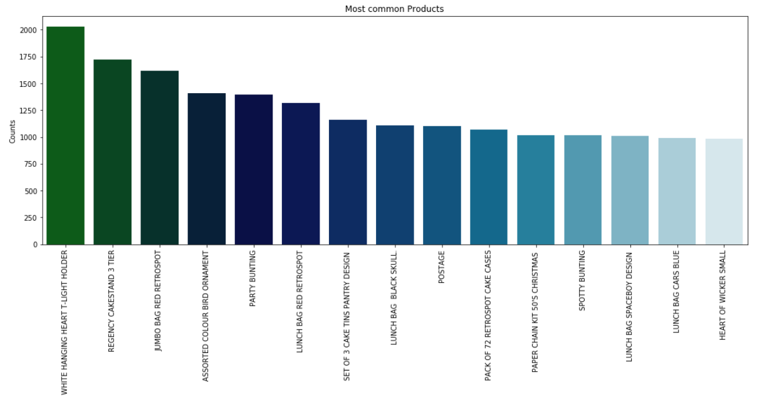
COLUMN : PRODUCT DESCRIPTION
This graph depicts the most common products in the dataset
The maximum product which is sold is the white hanging heart T-Light holder with a value of 2028
To avoid going out of stock, the retailer should always keep ample amount of these.

Slide 10
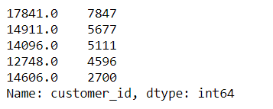
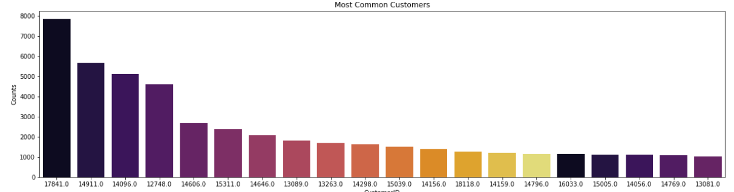
COLUMN : CUSTOMER ID
This graph depicts the most common customers in the dataset
The most common customer id is 17841 and has count 7847.
The top ten common customers can be awarded with coupons or some special discounts so that they don’t stop purchasing.

Slide 11

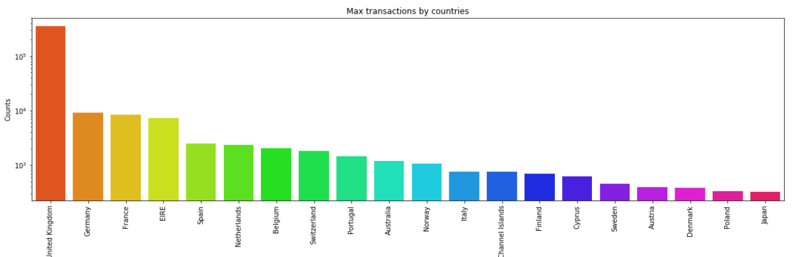
COLUMN : Transaction Country
This graph depicts the transactions by different countries.
The maximum number of transactions is by United Kingdom, as the retail store is UK based.
Approximately 89% of the transactions took place in the united kingdom.
For proper visualisation, we can create attributes of within and outside UK.

Slide 12
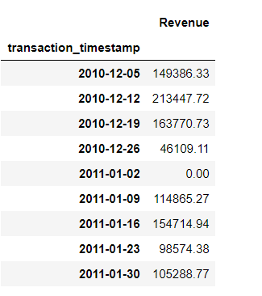
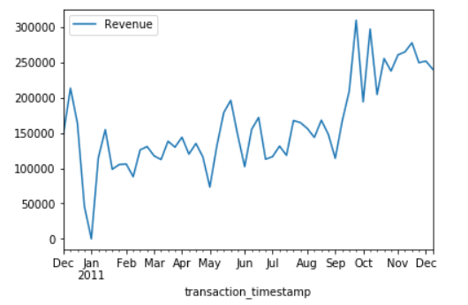
Below is the time series plot of the revenue, where we can observe the sum of the revenue against the months of that year.
It does not have a strictly increasing trend, it is increasing but with irregularities.
In the month of January, on a particular day, there is no revenue,odd.
The maximum revenue is generated around the month of october.
The above table shows that the sum of revenue was zero in the on the second of January, which suggests that the shop might be closed due to the holiday season.

Slide 13
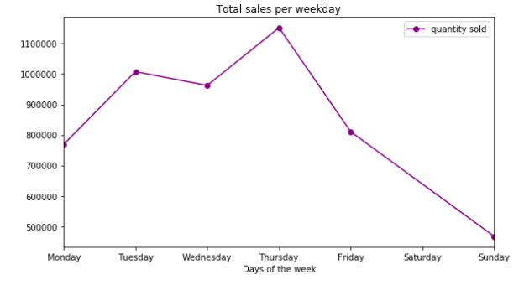
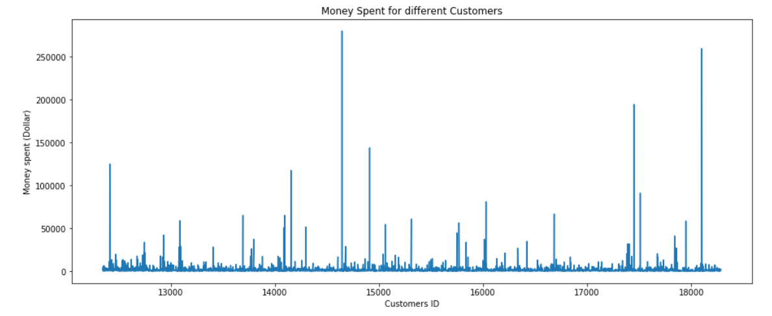
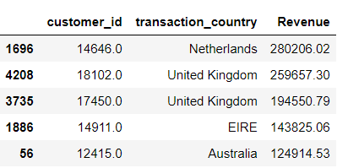
The graph on the right depicts that :
The maximum no of products were sold on Thursday.
The sales for Saturday are zero, possibly the shop is closed on that day.
The graphs on the bottom show revenue, money spent for different customer id’s and the transaction country.
Netherlands has spent the maximum amount of revenue.

Slide 14
RFM ANALYSIS

Slide 15
Recency
The more recently a customer has made a purchase with a company, the more likely he or she will continue to keep the business and brand in mind for subsequent purchases. Compared with customers who have not bought from the business in months or even longer periods.
Frequency
The frequency of a customer’s transactions may be affected by factors such as the type of product, the price point for the purchase, and the need for replenishment or replacement.
Monetary
Monetary value stems from the lucrativeness of expenditures the customer makes with the business during their transactions. A natural inclination is to put more emphasis on encouraging customers who spend the most money to continue to do so.

Slide 16
RFM SCORE :
Each of the RFM parameters will be assigned a score in the range of 1-5 with 5 being the best score. For example, a customer who made a purchase just recently while having bought a lot of products already before and has spent a lot of money during the purchases will have an RFM score of 555. On the other hand, a customer who bought only one very cheap product a long time ago will have an RFM score of 111.
Segments | RFM Score
Champions | 555, 554, 544, 545, 454, 455, 445
Loyal | 543, 444, 435, 355, 354, 345, 344, 335
Potential Loyalist | 553, 551, 552, 541, 542, 533, 532, 531, 452, 451, 442, 441, 431, 453, 433, 432, 423, 353, 352, 351, 342, 341, 333, 323
Promising | 525, 524, 523, 522, 521, 515, 514, 513, 425,424, 413,414,415, 315, 314, 313
Needs attention | 535, 534, 443, 434, 343, 334, 325, 324
Can’t lose but losing | 155, 154, 144, 214,215,115, 114, 113
Lost | 111, 112, 121, 131,141,151

Slide 17
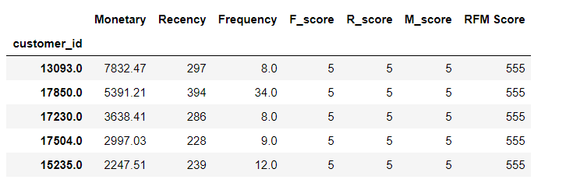
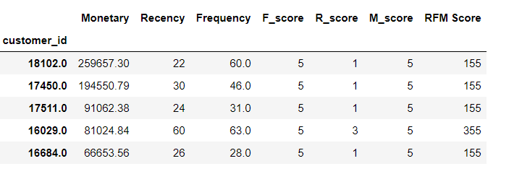
BEST CUSTOMERS
Recency, frequency, monetary all are high.
LOYAL CUSTOMERS
Frequency value should be high as compared to other parameters.

Slide 18
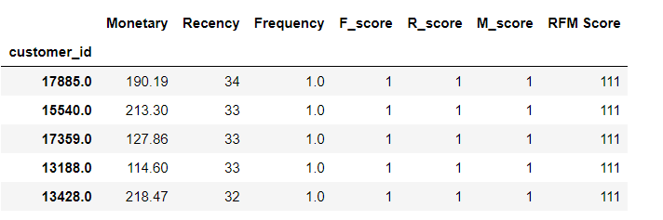
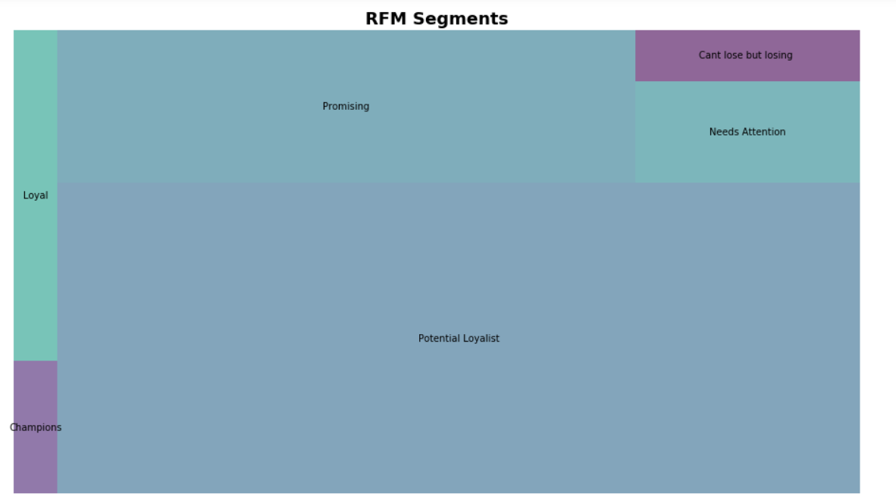
LOST CUSTOMERS
All the three parameters are low.
The segment chart was made according the RFM score table given on the previous slide.

Slide 19
We observe that a large proportion are potential loyalist to make them loyal, we can offer personalised recommendation,membership program,etc.
For promising : Offer coupons. Bring them back to the platform and keep them engaged.
For Champions : Reward them, they can send referrals and promote the brand
For Loyal : Ask for reviews, keep in touch
For Loyal : Offer coupons, bring them back to the platform and keep them engaged.
For Needs Attention: Make limited time offers
For Can’t lose but losing : Win them back via renewals or newer products, don’t lose them to competition.
WHY RFM?
RFM segmentation allows analysts to target specific clusters of customers with communications that are much more relevant for their particular behavior – and thus generate much higher rates of response, plus increased loyalty and customer lifetime value.

